Slide 1
Indonesian Presidents Group Study Tour in Chongqing
China Literature and Art Foundation
The Belt and Road Initiative Cultural Development Special Fund
Series of China Study Tour Activities –Thousands of School Presidents Group

Slide 2
01
Background
02
Organizer
03
About Chongqing
04
Itinerary Arrangement

Slide 3
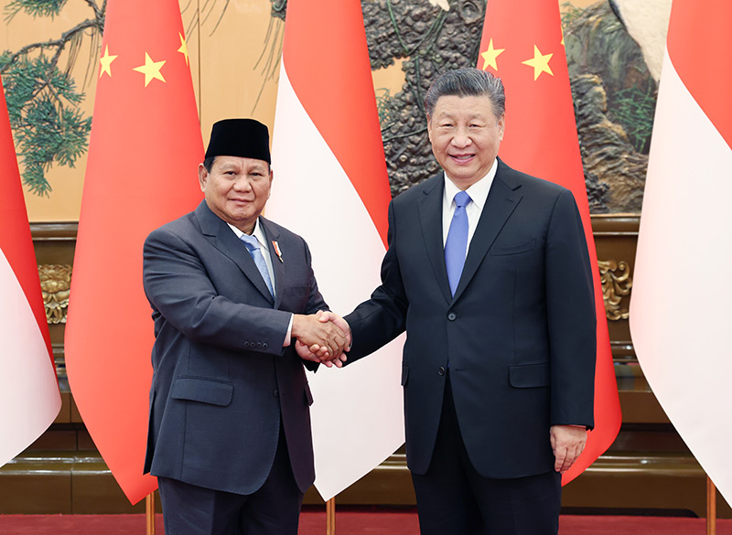
Indonesian Presidents Group · Study Tour in Chongqing
【Background】
China and Indonesia have a long history of friendly exchanges, and the ancient Maritime Silk Road once closely linked the two sides. The comprehensive strategic partnership between the two countries continues to deepen, and the cooperation and mutual support between the two countries under the multilateral framework have promoted prosperity and development in the region. In recent years, the two countries have had frequent high-level exchanges, with leaders of the two countries visiting each other many times and meeting each other many times in different international occasions. Both sides agreed that the Chinese civilization's "good neighborliness" and "harmony in diversity" ideas and Indonesia's "mutual assistance and cooperation" and "different paths leading to the same goal" cultural concepts have been integrated and interconnected, strengthening the spirit of jointly building a China-Indonesia community with a shared future.
The exchange potential between the two countries in the fields of tourism, education, youth, science and technology, sports and so on is constantly being released, and cultural exchanges have become a new driving force for the development of bilateral relations.

Slide 4
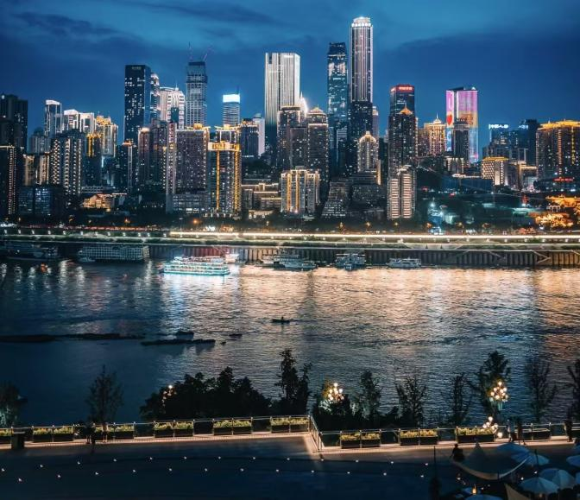
Indonesian Presidents Group · Study Tour in Chongqing
【Organizer】
Guide Party：
Chongqing Municipal Government
Support Party：
China Central Broadcasting Network
Xinhua News Agency
Host Party：
International College of Southwest University
Undertake Party：
China Literature and Art Foundation
(The Belt and Road Initiative Cultural Development Special Fund)
Chongqing Dongxueji Culture Communication Co., Ltd

Slide 5
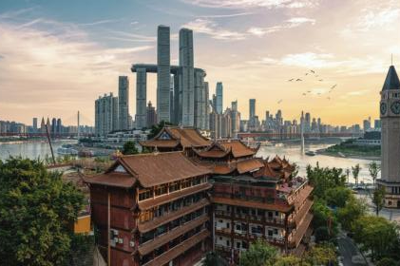
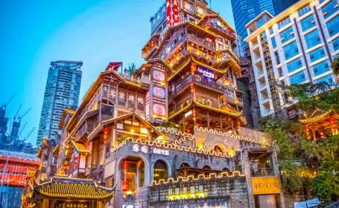
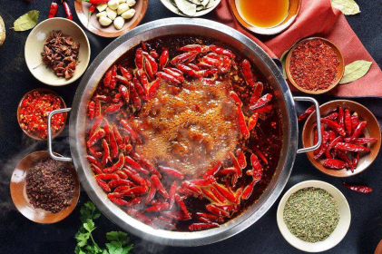
Indonesian Presidents Group · Study Tour in Chongqing
【About Chongqing】
Chongqing, abbreviated as Mountain City, is a provincial administrative region of the People’s Republic of China, the only municipality directly under the Central and Western Regions, a national central city and a megacity. It is one of the important central cities in China approved and determined by the State Council, the economic center of the upper reaches of the Yangtze River, and an important national modern manufacturing base, comprehensive transportation hub in the southwest region, bridgehead of China’s Belt and Road Initiative.
The city’s unique geographical landscape, rich history and culture, attractive food and snacks, and the prosperous charm of a modern city attract countless domestic and foreign tourists.

Slide 6
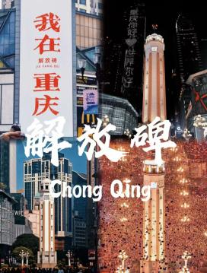
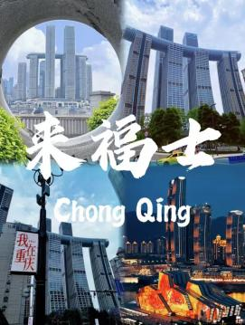
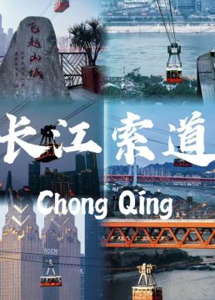
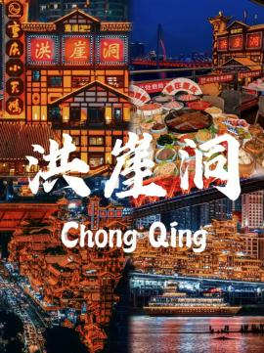
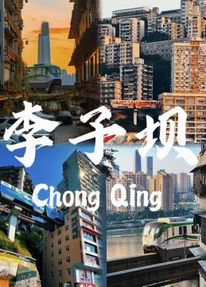
Indonesian Presidents Group · Study Tour in Chongqing
Liberation Monument
Raffles City
Yangtze River Cableway
Hongya Cave
Liziba Station
Mountain City Impression：Three-dimensional Interwoven Wonders
Food Paradise：Special Food of Chongqing
Historical Footprint：The Depth and Richness of Culture
Natural Scene：Clear Waters and Green Hills
Modern Megacity：The Fusion of Technology and Fashion

Slide 7
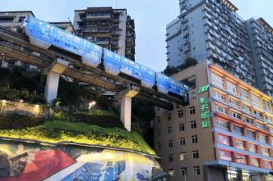
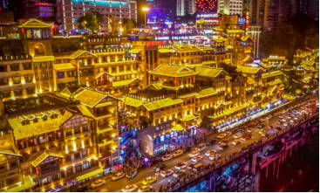
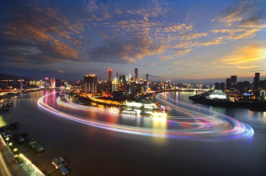
【 Itinerary Arrangement 】
Chongqing
DAY 1 - Scheduling
DAY 1 | Hello! Chongqing!
Arrive at Chongqing by plane | Trip, Airport pickup, Sign in, Check in
China·Chongqing

Slide 8
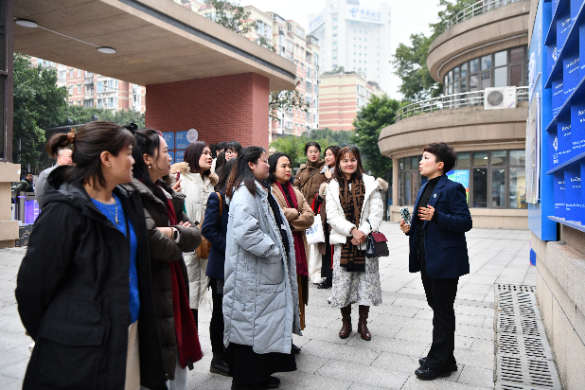
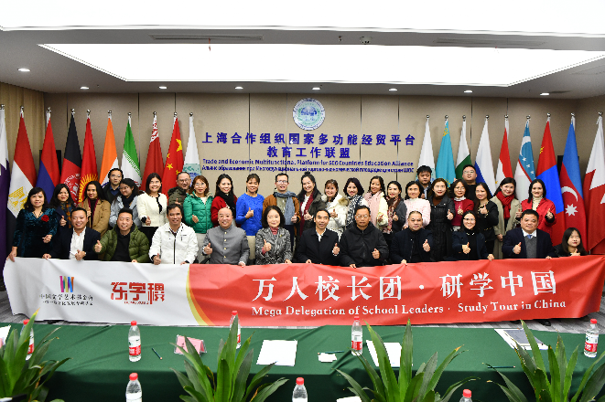
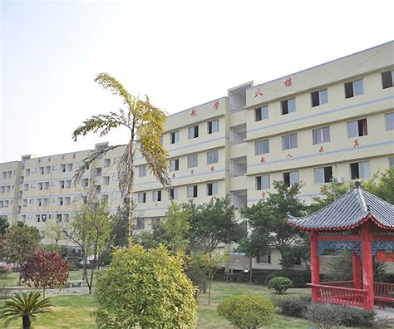
Chongqing
DAY 2-3 Scheduling
DAY 2-3 | Southwest University
Visit Southwest University & Seminar | Southwest University：Immersive Learning Experience Day 2： Morning Schedule：Visit the university, College History Museum, College Museum, Laboratory, group photo and lunch Afternoon Schedule：Seminar Day 3: Whole-Day Schedule: Seminar Seminar Themes: The Development History of Chinese Universities, Interpretation of Study in China Policy, Sharing of Teaching Achievement, Leadership and Scientific Technology, Certificate Ceremony and Signing Ceremony, etc. Note： The above schedule is for reference only and subject to actual arrangement
China·Chongqing

Slide 9
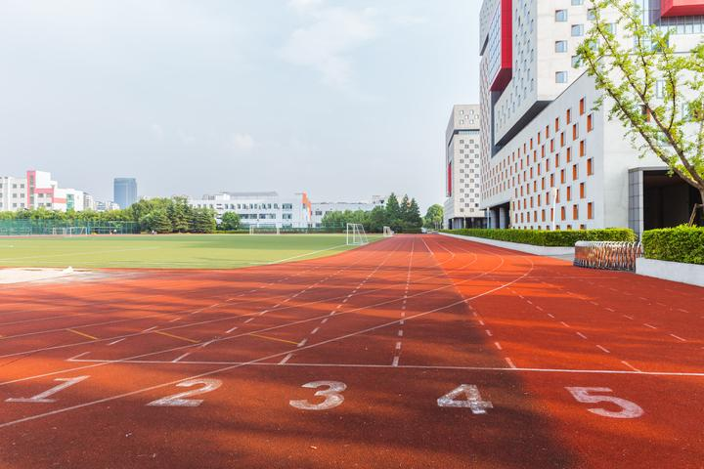
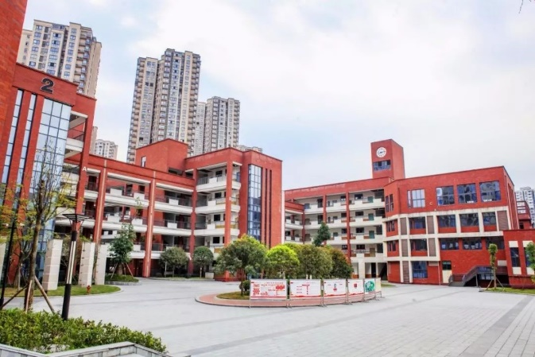
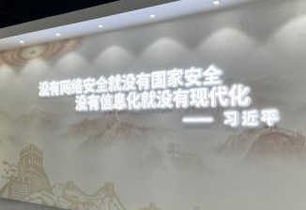
Chongqing
DAY 4 Scheduling
DAY 4 | Chongqing Schools
Tour and Visit | School Tour：Exploratory Visit Day 4 Morning Schedule: Visit prestigious university in Chongqing Afternoon Schedule: Visit prestigious high school in Chongqing Note： The above schedule is for reference only and subject to actual arrangement
China·Chongqing

Slide 10
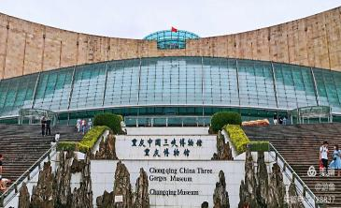
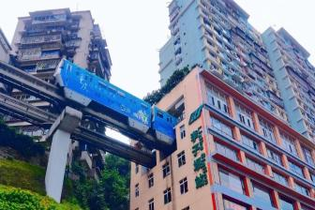
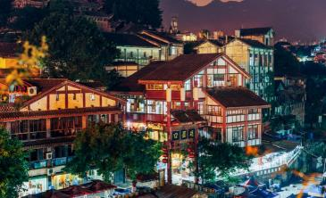
Chongqing
DAY 5 - Scheduling
DAY 5 | City Tour
Beauty of Chongqing: Urban Antiquity | 1. Visit millennial ancient town- Ciqikou 2. Experience 8D megacity- Liziba metro passes through the building 3. Percept Bashu Culture - Three Gorges Museum
China·Chongqing

Slide 11
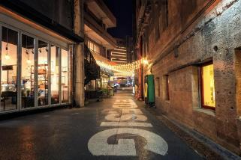
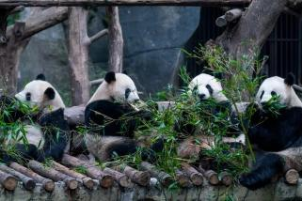
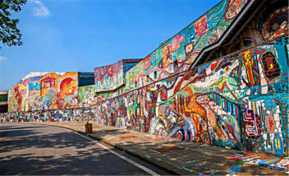
Chongqing
DAY 6 - Scheduling
DAY 6 | City Tour
Beauty of Chongqing: Cityscape | 1. Sightseeing TESTBED2 2. Mountain City Trail, Eighteen Tiers in Chongqing 3. Yangtze River Cableway, Liberation Monument Food Street 4. Night Scene: Yangtze River and Jialing River
China·Chongqing

Slide 12
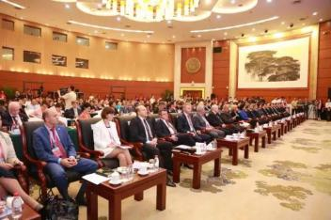
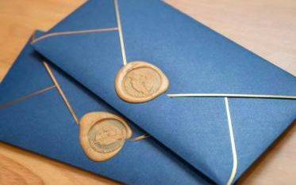
Chongqing
DAY 7 - Scheduling
DAY 7 | See you again, China!
Return | Fly back to Indonesia
China·Chongqing

Slide 13
Indonesian Presidents Group · Study Tour in Chongqing
High-standard Luxury Configuration through the Whole Study Tour
I. Travel Time：7 days of immersive experience and exchange in China
II. Hotel：Luxury four-star hotel（Except for college experience）
III. Catering：Four-star Hotel Buffet, local popular restaurant, etc. （Except for college experience）
IV. Transportation: Luxury Special Car（With full-time driver）
V. Content：Attractive scenic spots & High-quality research and learning experience
VI. Fee： 8,000 RMB/person (the previous group fee)
2,000 RMB/person (excluding air tickets & visa)
Note：The tour fee is subsidized by the Belt and Road Cultural Development Special Fund of the China Literature and Art Foundation.
【 Itinerary Specification】

Slide 14
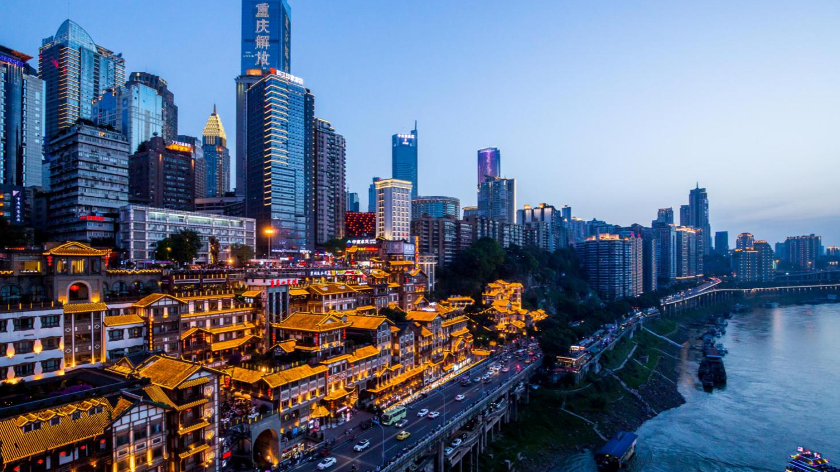
Welcome to China !

